Slide 1
Linear Regression
Presented By:
Punit Kumar Johari
Assistant Professor
CSE & IT Department
MITS, Gwalior

Slide 2
Content
Introduction to machine learning
Machine Learning Algorithms
Application of Linear Regression
Understanding Linear Regression
Multiple Linear Regression
Use Case

Slide 3
Introduction to Machine Learning
An Overview

Slide 4
Independent and Dependent Variable
Independent Variable - A variable whose value does not change by the effect of other variables and is used to manipulate the dependent variable. It is often denoted as X.
Basics
Dependent variable - A variable whose value change when there is any manipulation in the values of independent variables. It is often denoted as Y.

Slide 5

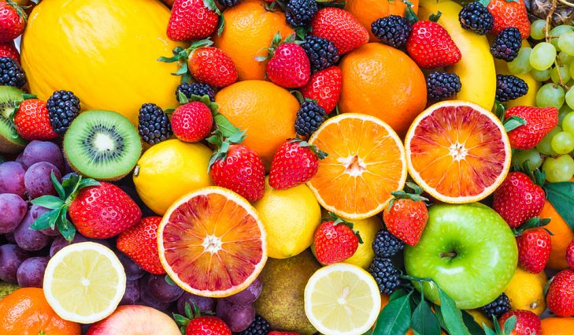
Based on amount of rainfall, How much would be the crop yield?
Crop Yielded depends upon the amount of rainfall received

Slide 6
Numerical and Categorical values
Data
Numerical
Categorical
Age
Salary
Height
Color
Animal’s Breed
Gender

Slide 7
Machine Learning Algorithms
Supervised
Un Supervised
Regression
Classification
Simple
Multiple
Polynomial

Slide 8
Application of Linear Regression

Slide 9
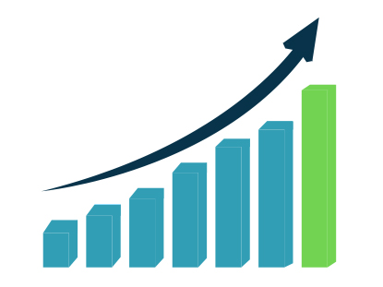
Economic Growth
Used to determine the Economic growth of a country or a state in the coming quarter, can also be used to predict the GDP ofa country.

Slide 10

Product Price
Can be used to predict what would be the price of the product in the future.

Slide 11
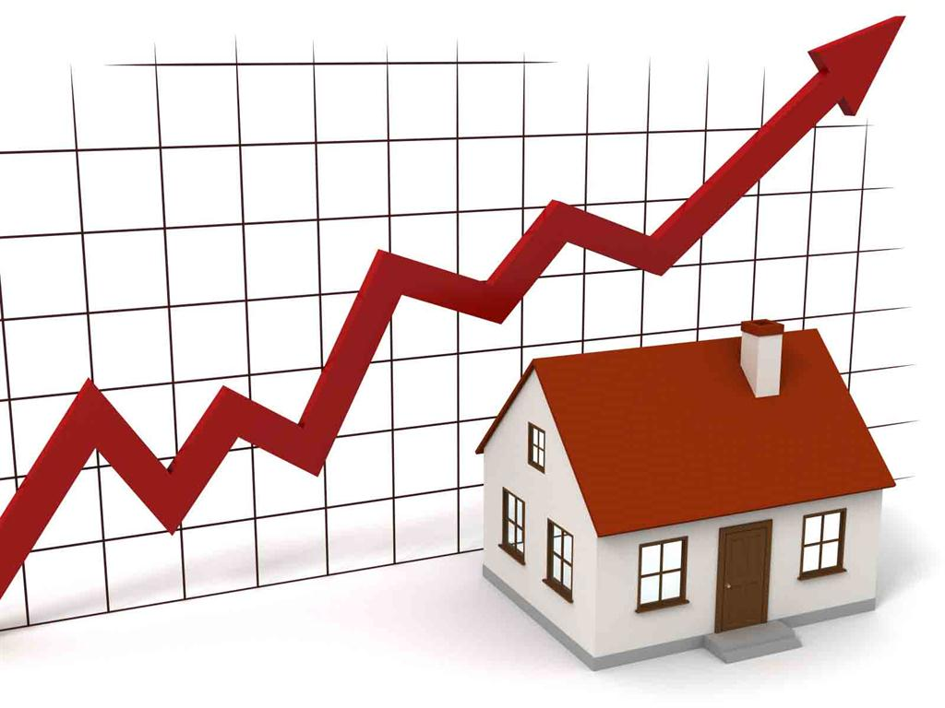
Housing Sales
To estimate the number of houses a builder would sell and at what price in the coming months.

Slide 12
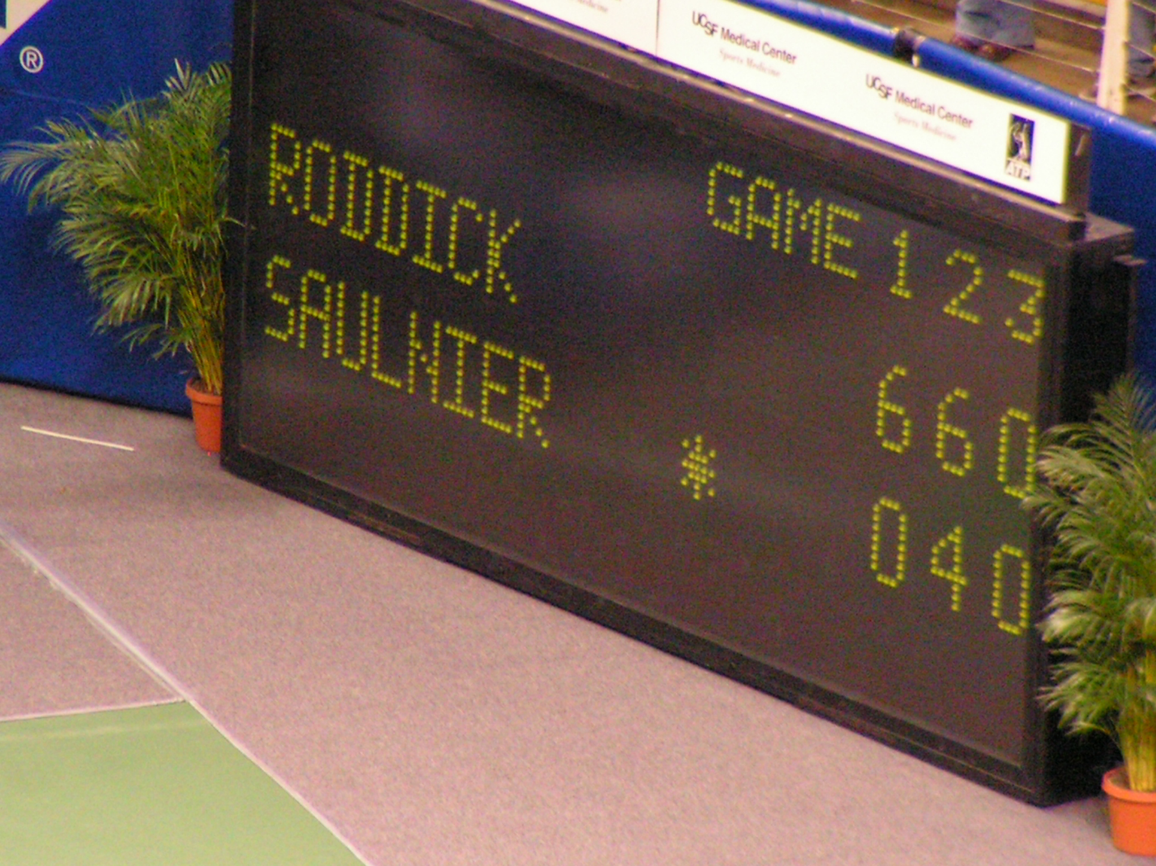
Score Prediction
To predict the number of runs a player would score in the coming matches based on previous performance.

Slide 13
Understanding Linear Regression

Slide 14
Examine 2 Factors
Which variables in particular are significant predictors of the outcome variables?
How significant the Regression line to make predictions with highest possible accuracy.
Linear Regression is a statistical model used to predict the relationship between independent and dependent variables.

Slide 15
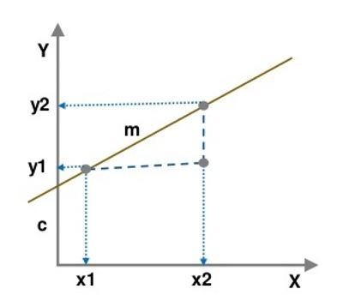
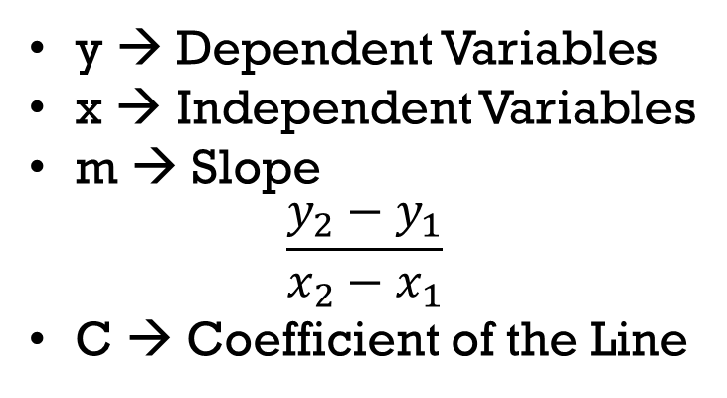
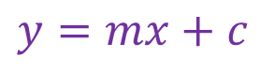
Regression Equation
The simplest form of a simple linear regression equation with one dependent and one independent variable is represented by:
$$y=mx+c$$
y → Dependent Variables
x → Independent Variables
m → Slope
$$\frac{y_{2}−y_{1}}{x_{2}−x_{1}}$$
C → Coefficient of the Line

Slide 16
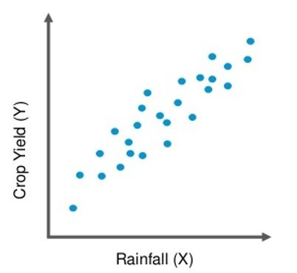
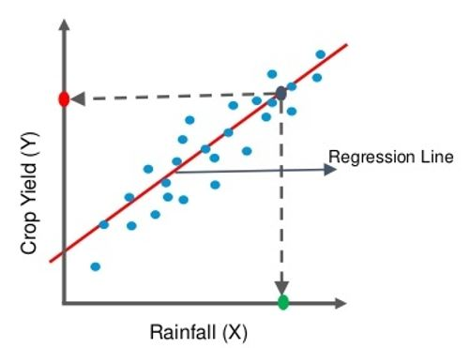
Prediction Using the Regression Line.
The Red point on the y axis is the amount of Crop Yield you can expect for some amount of Rainfall (X) represented by Green dot.
Plotting the amount of Crop Yield based on the amount of Rainfall

Slide 17
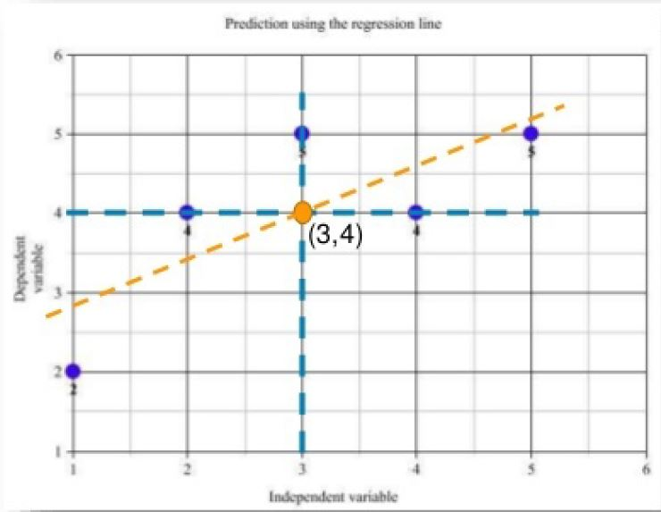
Intuition behind the regression Line
Regression line should ideally pass through the mean of X and Y.
Independent Variable X | Dependent Variable Y
1 | 2
2 | 4
3 | 5
4 | 4
5 | 5
3
4
Regression Line
Mean

Slide 18
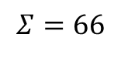
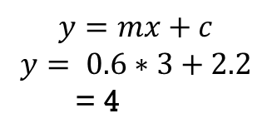
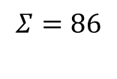
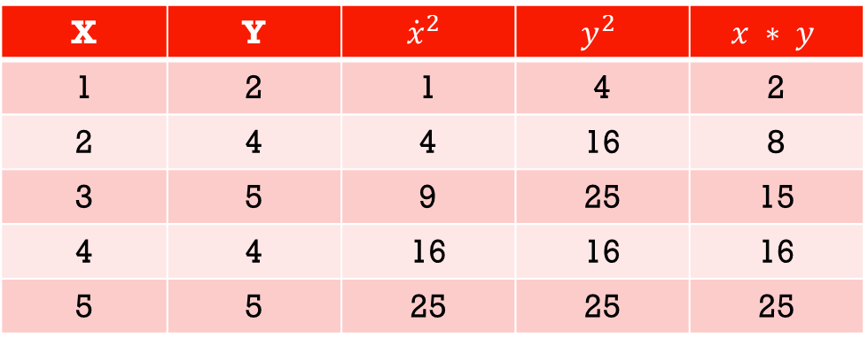
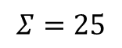
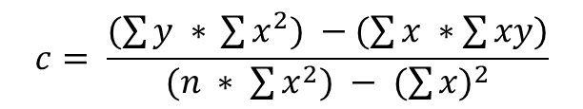
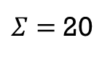
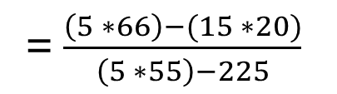
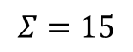
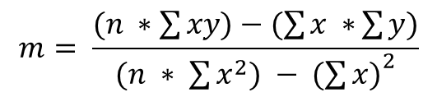
Intuition behind the regression Line
Drawing the Equation of the Regression line
X | Y | $${\dot{x}}^{2}$$ | $$y^{2}$$ | $$x ∗ y$$
1 | 2 | 1 | 4 | 2
2 | 4 | 4 | 16 | 8
3 | 5 | 9 | 25 | 15
4 | 4 | 16 | 16 | 16
5 | 5 | 25 | 25 | 25
$$y=mx+c$$
$$y= 0.6∗3+2.2$$
= 4
$$Σ=15$$
$Σ=$20
$$Σ=25$$
$$Σ=86$$
$$Σ=66$$
$$m= \frac{(n ∗\sum{xy)−(\sum{x ∗}\sum{y})}}{(n ∗ \sum{x^{2}) − {(\sum{x)}}^{2}}}$$
= $\frac{\left(5 ∗66\right)−(15 ∗20)}{\left(5 ∗55\right)−225}$
= 0.6
$$c= \frac{(\sum{y ∗ }\sum{x^{2}) −(\sum{x} ∗\sum{xy)}}}{(n ∗ \sum{x^{2}) − {(\sum{x})}^{2}}}$$
= 2.2

Slide 19
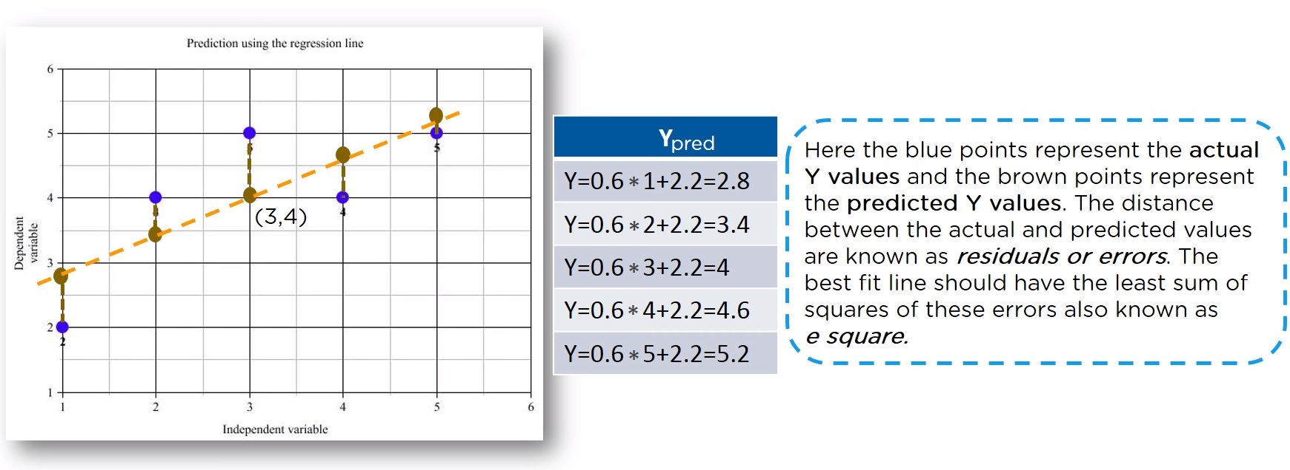
Intuition behind the regression Line
Lets find out the predicted values of Y for corresponding values of X using the linear equation where m-0.6 and c=2.2

Slide 20
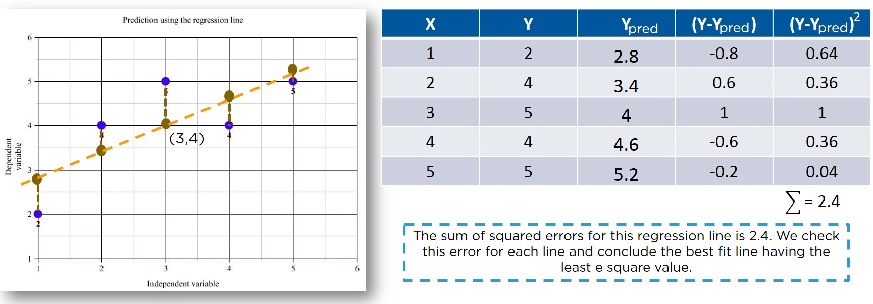
Intuition behind the regression Line
Lets find out the predicted values of Y for corresponding values of X using the linear equation where m=0.6 and c=2.2

Slide 21
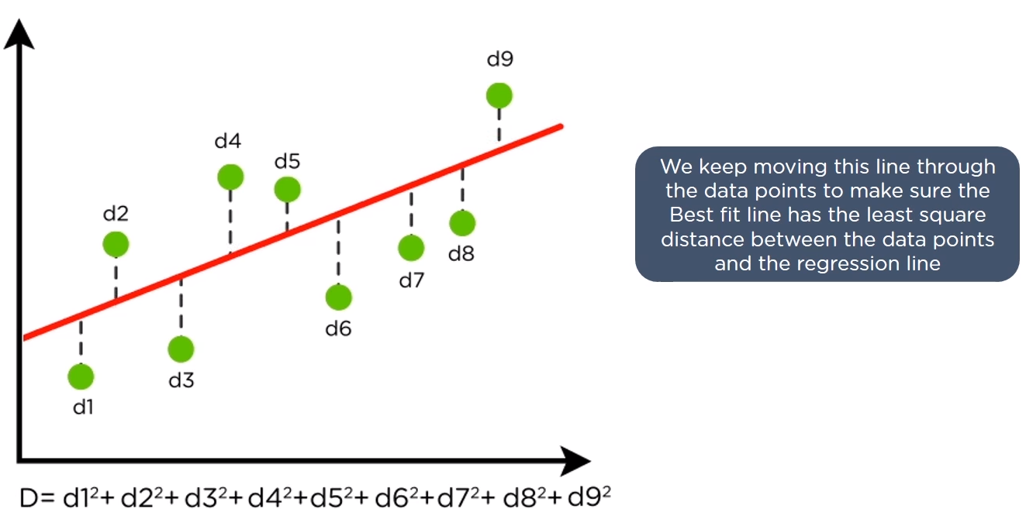
Finding the Best Fit Line
Minimizing the Distance: There are lots of ways to minimize the distance between the line and the data points like Sum of Squared errors, Sum of Absolute errors, Root Mean Square error etc.

Slide 22
Multiple Linear Regression

Slide 23
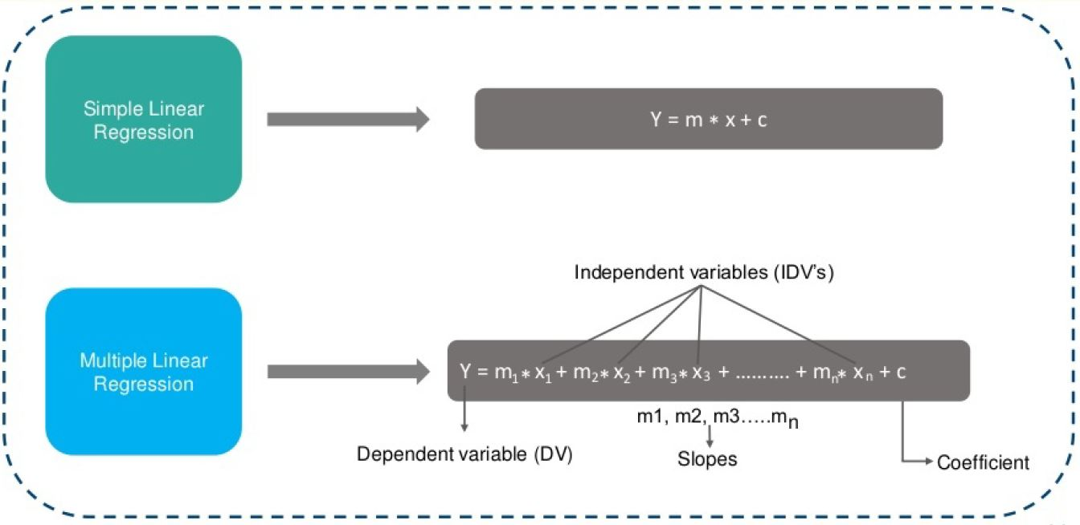
Multiple Linear Regression

Slide 24
Implementation of Linear Regression
Use Case

Slide 25

Let’s Understand how the Linear Regression Works by implementing it in Python
For instance we will use Python 3.7 Version for Windows platform.

Slide 26


You may use any of the API depending on the configuration compatible with your system
Jupyter Notebook
Google Colab

Slide 27

Presented By:
Punit Kumar Johari
Assistant Professor
CSE & IT Department
MITS, Gwalior
Email: pkjohari@mitsgwalior.in

